Slide 1
Subnetting - visual
S Ward Abingdon and Witney College CCNA Exploration Semester 1
Notes:
S Ward Abingdon and Witney College

Slide 2
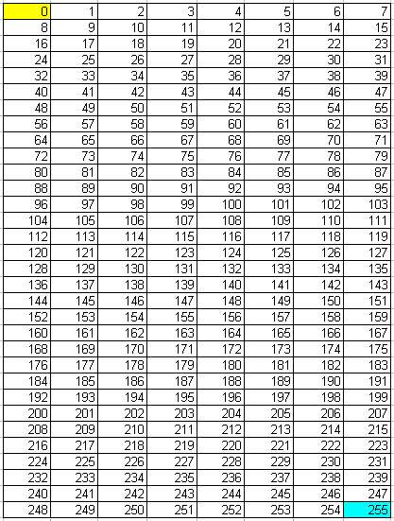
Prefix /24
Three octets in network part, last octet in host part.
All possible numbers 0 – 255 in last octet belong in the same network.
Network address yellow
Broadcast address blue
Subnet mask 255.255.255.0
S Ward Abingdon and Witney College CCNA Exploration Semester 1

Slide 3
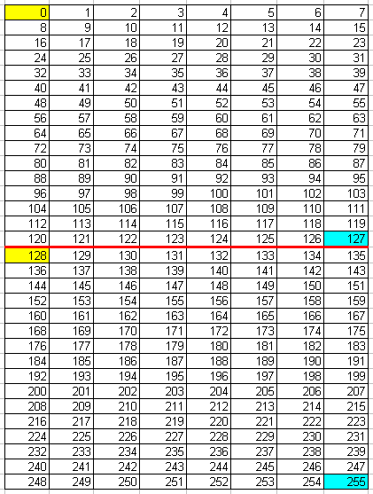
Prefix /25
First bit of fourth octet taken into network part.
For every bit taken, double number of networks, halve their size.
Network address yellow
Broadcast address blue
Subnet mask 255.255.255.128
S Ward Abingdon and Witney College CCNA Exploration Semester 1

Slide 4
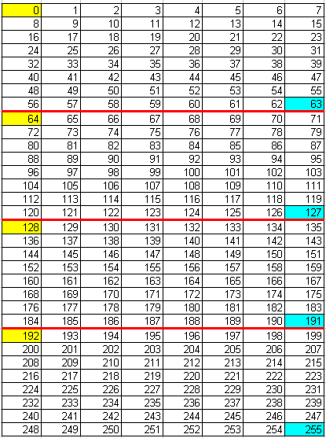
Prefix /26
2 bits of fourth octet taken into network part.
For every bit taken, double number of networks, halve their size.
Network address yellow
Broadcast address blue
Subnet mask 255.255.255.192
S Ward Abingdon and Witney College CCNA Exploration Semester 1

Slide 5
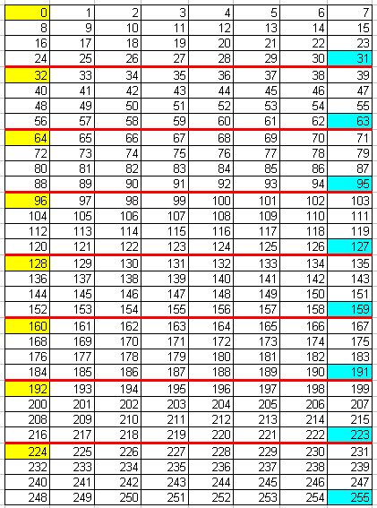
Prefix /27
3 bits of fourth octet taken into network part.
For every bit taken, double number of networks, halve their size.
Network address yellow
Broadcast address blue
Subnet mask 255.255.255.224
S Ward Abingdon and Witney College CCNA Exploration Semester 1

Slide 6
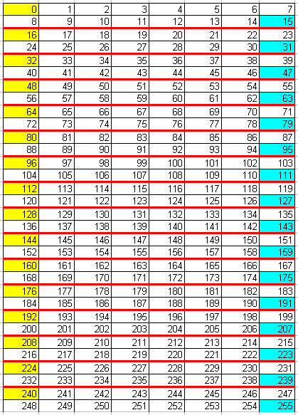
Prefix /28
4 bits of fourth octet taken into network part.
For every bit taken, double number of networks, halve their size.
Network address yellow
Broadcast address blue
Subnet mask 255.255.255.240
S Ward Abingdon and Witney College CCNA Exploration Semester 1

Slide 7
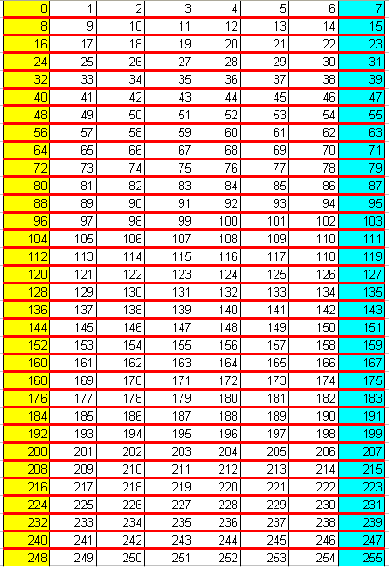
Prefix /29
5 bits of fourth octet taken into network part.
For every bit taken, double number of networks, halve their size.
Network address yellow
Broadcast address blue
Subnet mask 255.255.255.248
S Ward Abingdon and Witney College CCNA Exploration Semester 1

Slide 8
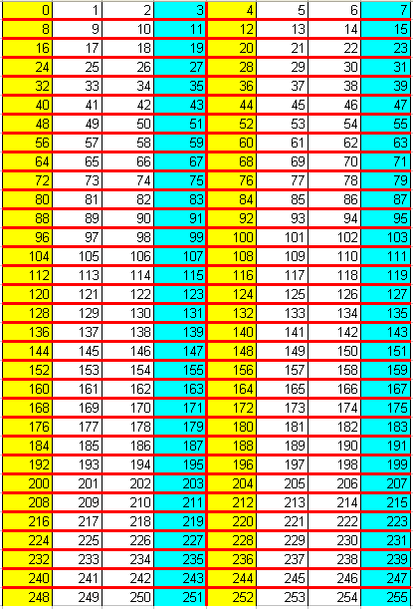
Prefix /30
6 bits of fourth octet taken into network part.
For every bit taken, double number of networks, halve their size.
Network address yellow
Broadcast address blue
Subnet mask 255.255.255.252
S Ward Abingdon and Witney College CCNA Exploration Semester 1

Slide 9
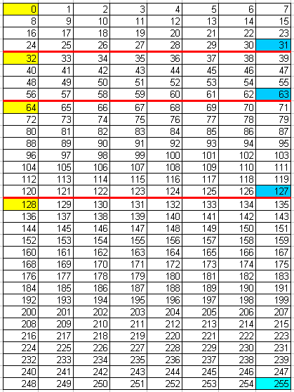
Variable length
/27
/26
/25
Networks do not need to be all the same size.
S Ward Abingdon and Witney College CCNA Exploration Semester 1

